Slide 1
IMAGE SCRAPPING AND CLASSIFICATION PROJECT

Slide 2
ACKNOWLEDGMENT
I take great pleasure to thank and acknowledgement the allowance by Data Trained Education and permission by Flip Robo. I extend whole hearted thanks to them I worked and learned a lot and sharing me the knowledge and experience.
Data Trained Education and Flip Robo provided training is the very important to completion of project.

Slide 3
INTRODUCTION
Business Problem Framing
Images are one of the major sources of data in the field of data science and AI. This field is making appropriate use of information that can be gathered through images by examining its features and details. We are trying to give you an exposure of how an end to end project is developed in this field.
Conceptual Background of the Domain Problem
The idea behind this project is to build a deep learning-based Image Classification model on images that will be scraped from e-commerce portal. This is done to make the model more and more robust.
Review of Literature
If you have ever tried performing image recognition using deep learning, you know the importance of a good dataset for training. However, finding sufficient images for training is not always easy, and the accuracy of your model is directly dependent of the quality of the training data.
Motivation for the Problem Undertaken
There are techniques you can use to supplement the images dataset that they use for training. One of the techniques is called image data augmentation.

Slide 4
Analytical Problem Framing
Mathematical/ Analytical Modeling of the Problem
Image data augmentation is a technique that creates new images from existing ones. To do that, you make some small changes to them, such as adjusting the brightness of the image, or rotating the image, or shifting the subject in the image horizontally or vertically.
Image augmentation techniques allow you to artificially increase the size of your training set, thereby providing much more data to your model for training. This allows you to improve the accuracy of your model by enhancing the ability of your model to recognize new variants of your training data.
Data Sources and their formats
I will first demonstrate the various image augmentation techniques using Python and Keras. If you want to try along, make sure you have the following software and packages installed:
TensorFlow. You can install TensorFlow using the command
!pip install tensorflow
Once selenium and tensorflow are installed, create a new Jupyter Notebook.

Slide 5
Analytical Problem Framing
Data Collection Phase: In this section, you need to scrape images from e-commerce portal, Amazon.com. The clothing categories used for scraping will be:
Sarees (women)
Trousers (men)
Jeans (men)
You need to scrape images of these 3 categories and build your data from it. That data will be provided as an input to your deep learning problem. You need to scrape minimum 200 images of each categories. There is no maximum limit to the data collection. You are free to apply image augmentation techniques to increase the size of your data but make sure the quality of data is not compromised.
Importing the Libraries:
!pip install selenium

Slide 6
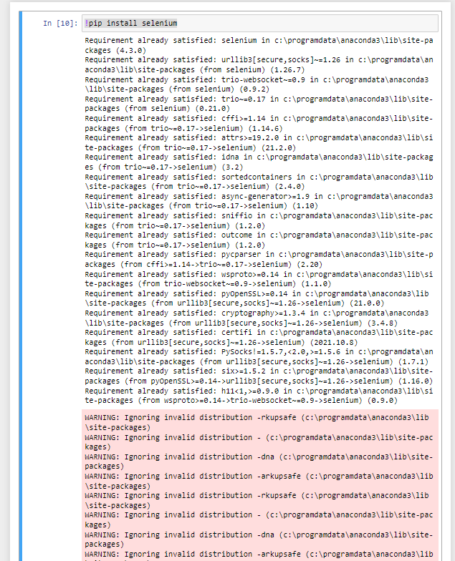
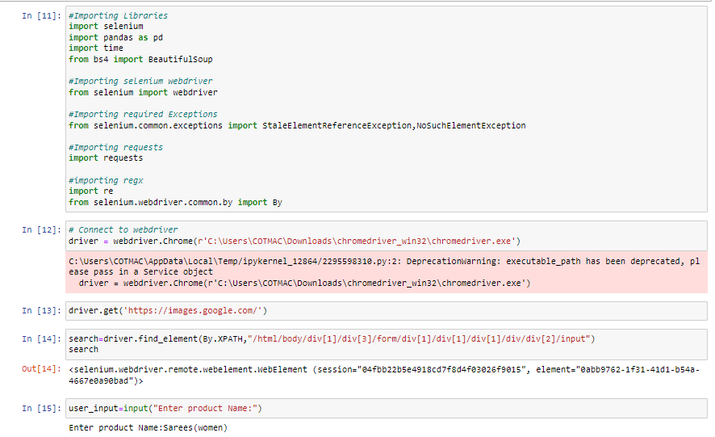
Data Sources & Formats
Collected dataset using scrapping the data as below:
Downloading the Sarees (women) images in the given path using webscrapping -

Slide 7
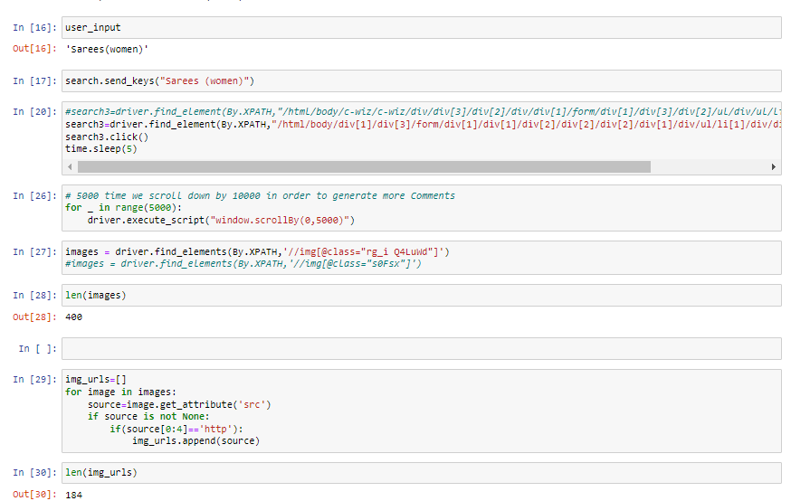
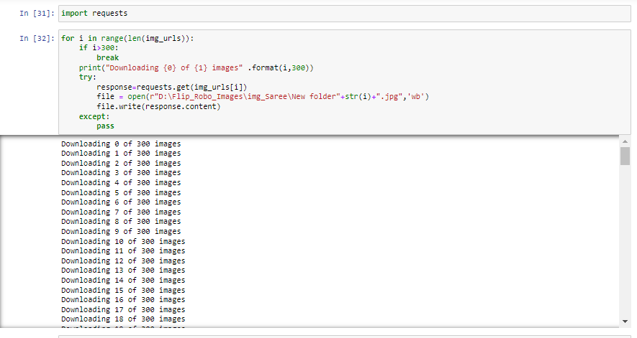
Downloading the Sarees (women) images in the given path using webscrapping -

Slide 8
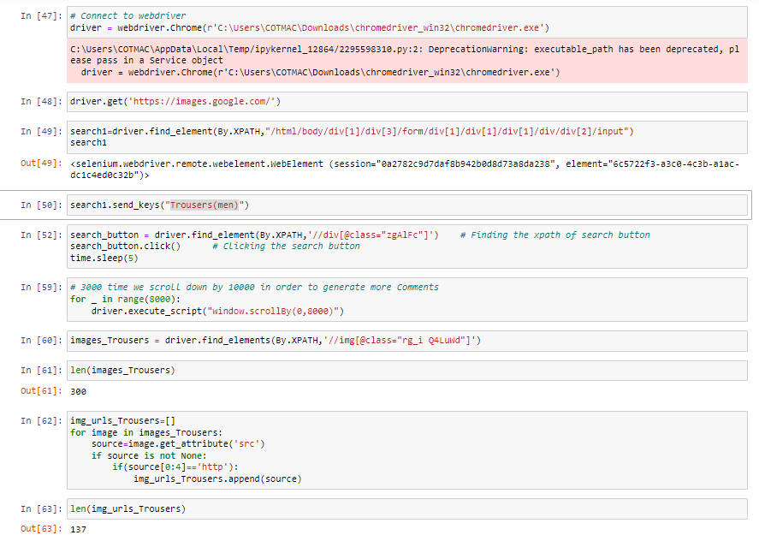
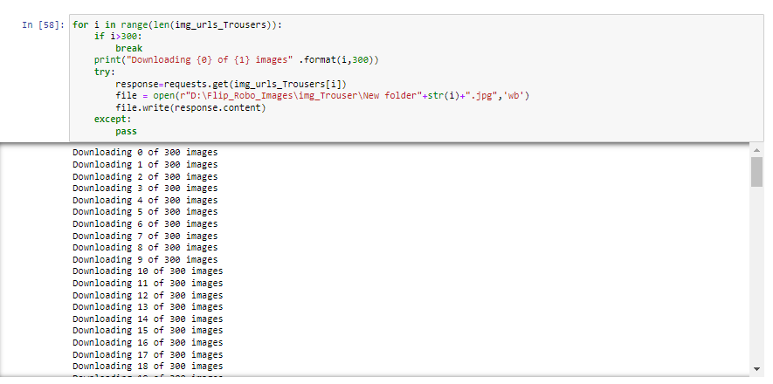
Downloading the Trousers(men) images in the given path using webscrapping

Slide 9
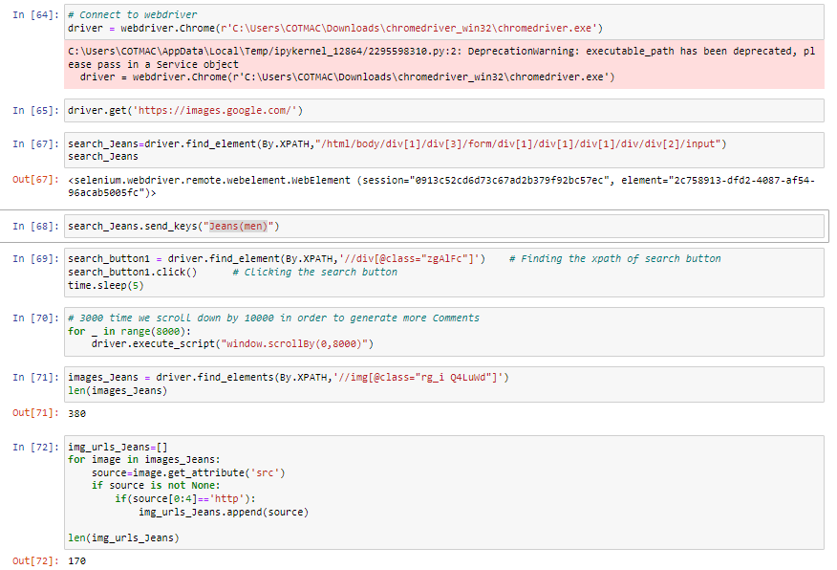
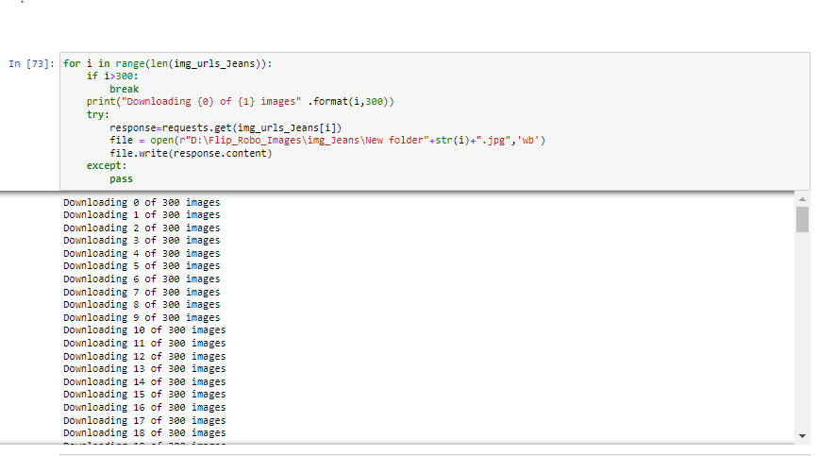
Downloading the Jeans(men) images in the given path using webscrapping

Slide 10
State the set of assumptions (if any) related to the problem under consideration
As given in datasets my assumption is predicting image scrapping Classification Problem

Slide 11
Hardware and Software Requirements and Tools Used
The needed time to train the model depends on the capability of the used system during the experiment. Some libraries use GPU resources over the CPU to take a shorter time to train a model. Also we are using Jupiter notebook for running the code.
Operating System | Windows 10
Processor | Core i7
RAM | 16GB
Graphics card | 1080 TI OC

Slide 12
Model/s Development and Evaluation
Importing Libraries
! pip install tensorflow
!pip install image
The ImageDataGenerator class allows your model to receive new variations of the images at each epoch. But do remember that it only returns the transformed images and does not add it to the set of images that you have.
Using Data Augmentation –
Image data augmentation is a technique that creates new images from existing ones. To do that, you make some small changes to them, such as adjusting the brightness of the image, or rotating the image, or shifting the subject in the image horizontally or vertically.
Types of Image Data Augmentation
Image augmentation comes in many forms, here are some of the common ones — Vertical shift, Horizontal shift, Vertical flip, Horizontal flip, Rotation, Brightness adjustment, and Zoom In/Out.

Slide 13
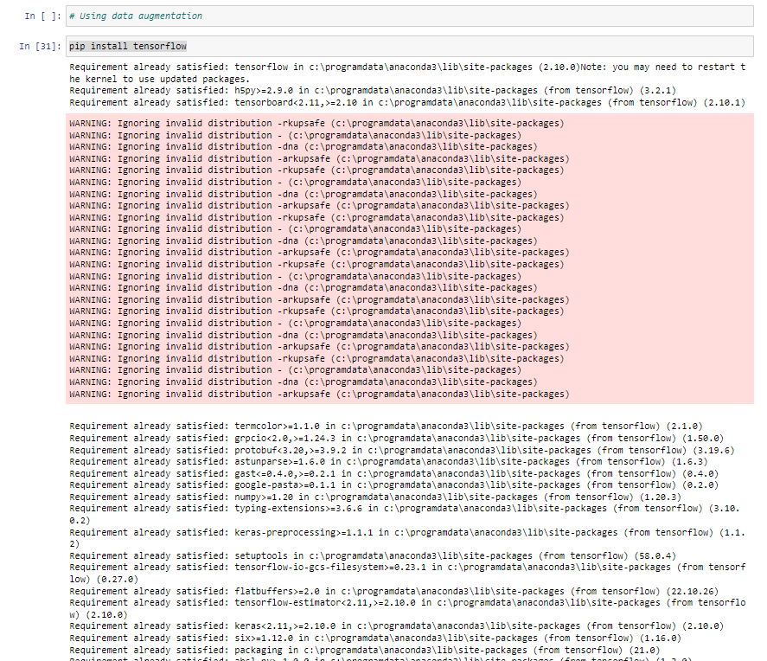
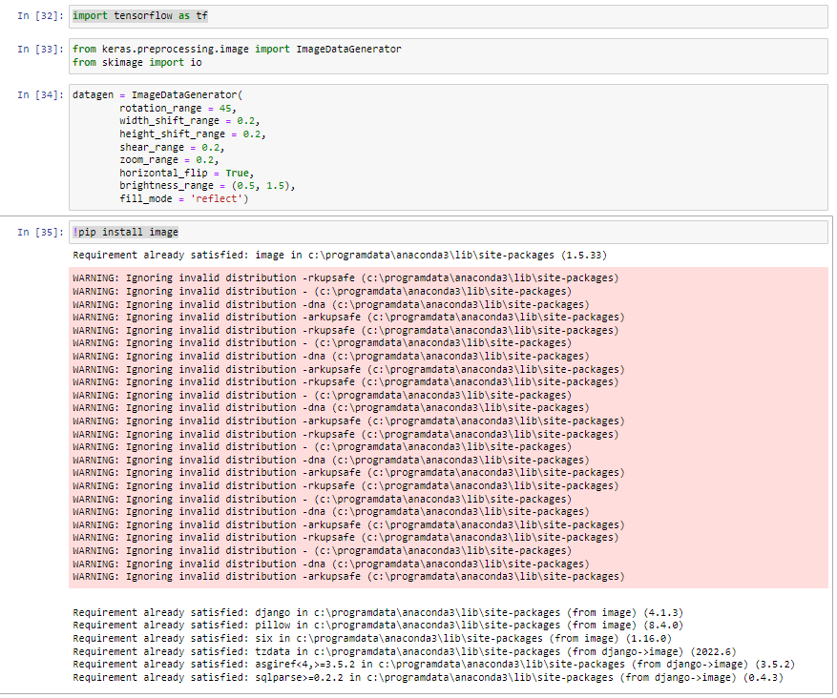
Using data augmentation

Slide 14
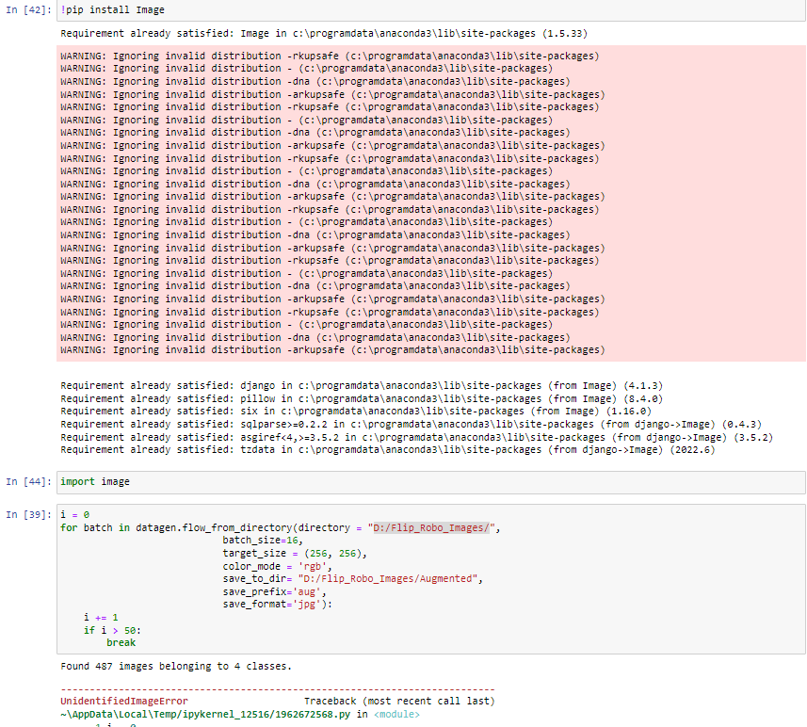
Using data augmentation

Slide 15
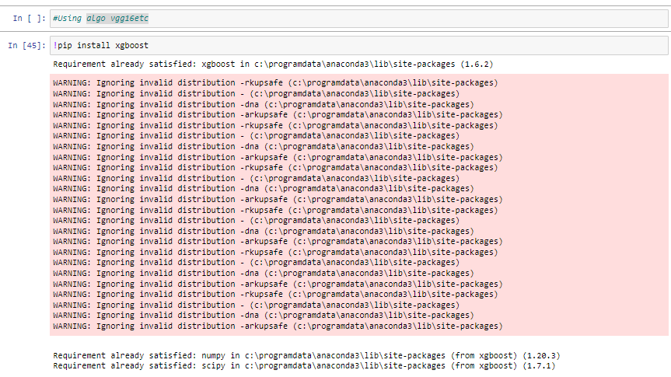
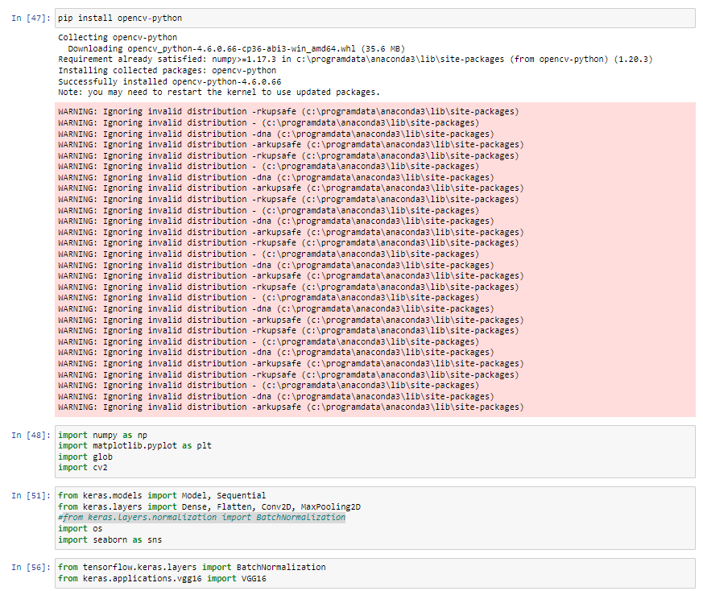
Using algo vgg16etc

Slide 16
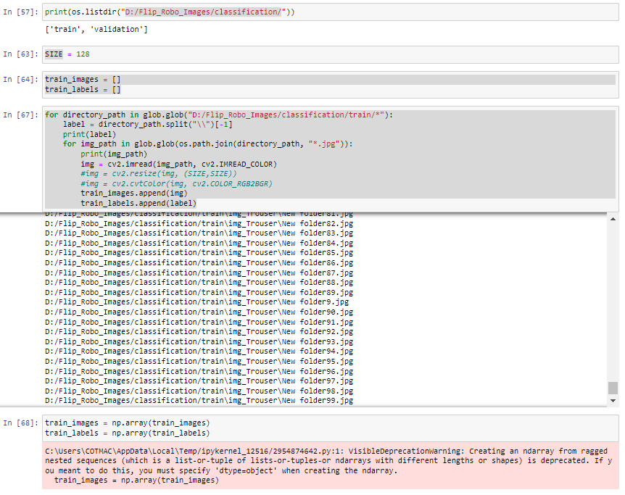
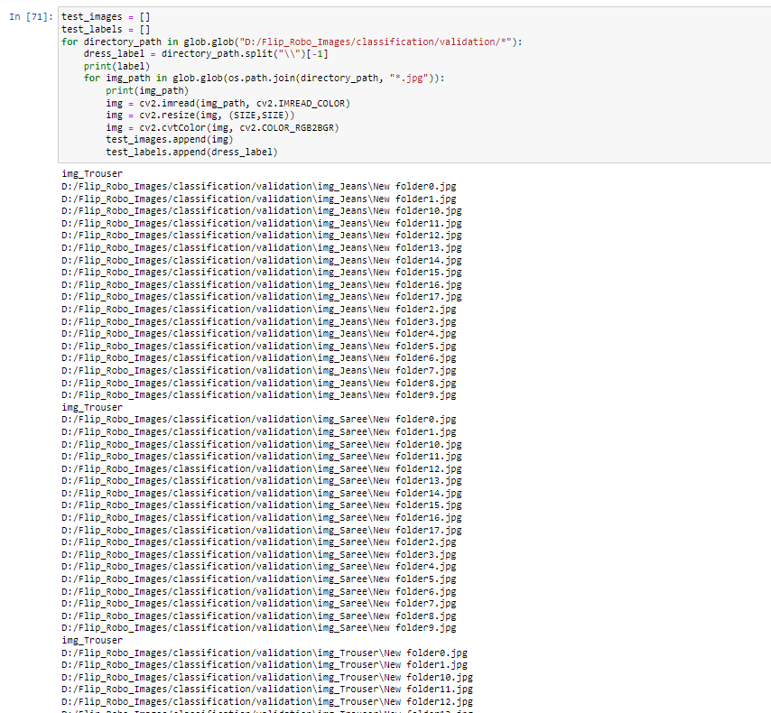
Using algo vgg16etc

Slide 17
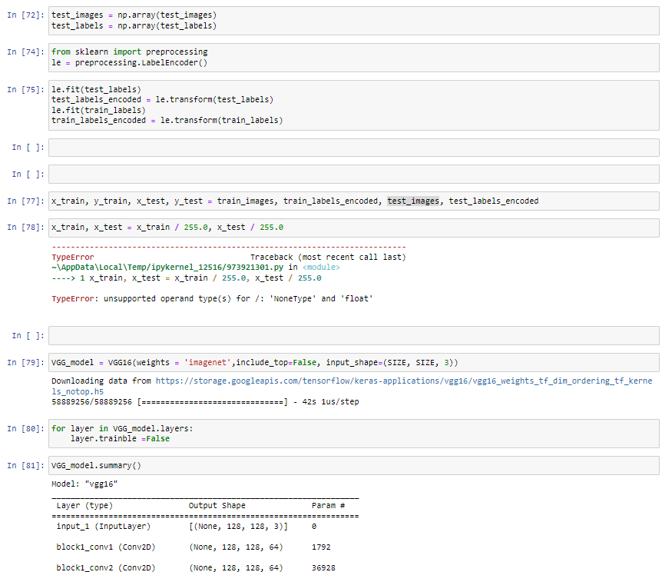
Using algo vgg16etc

Slide 18
Conclusion
Data Augmentation is used to Image editing like Vertical Shift, Horizontal Shift, Horizontal Flip, Rotation, Brightness.

